Slide 1
Characterization of mutational processes affecting metastatic transformation in melanoma and the impact on therapy
Laura Vo Ngoc
01 August, 2018

Slide 2
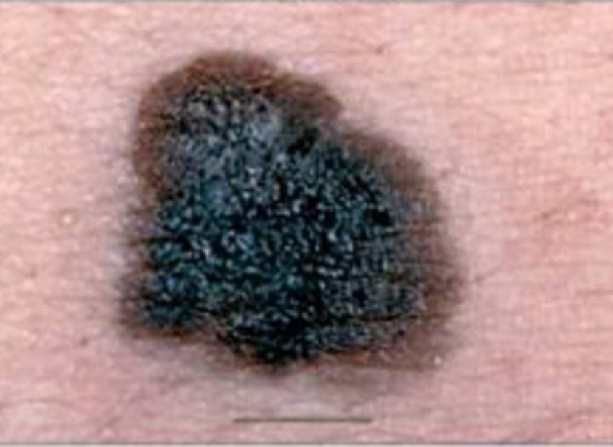
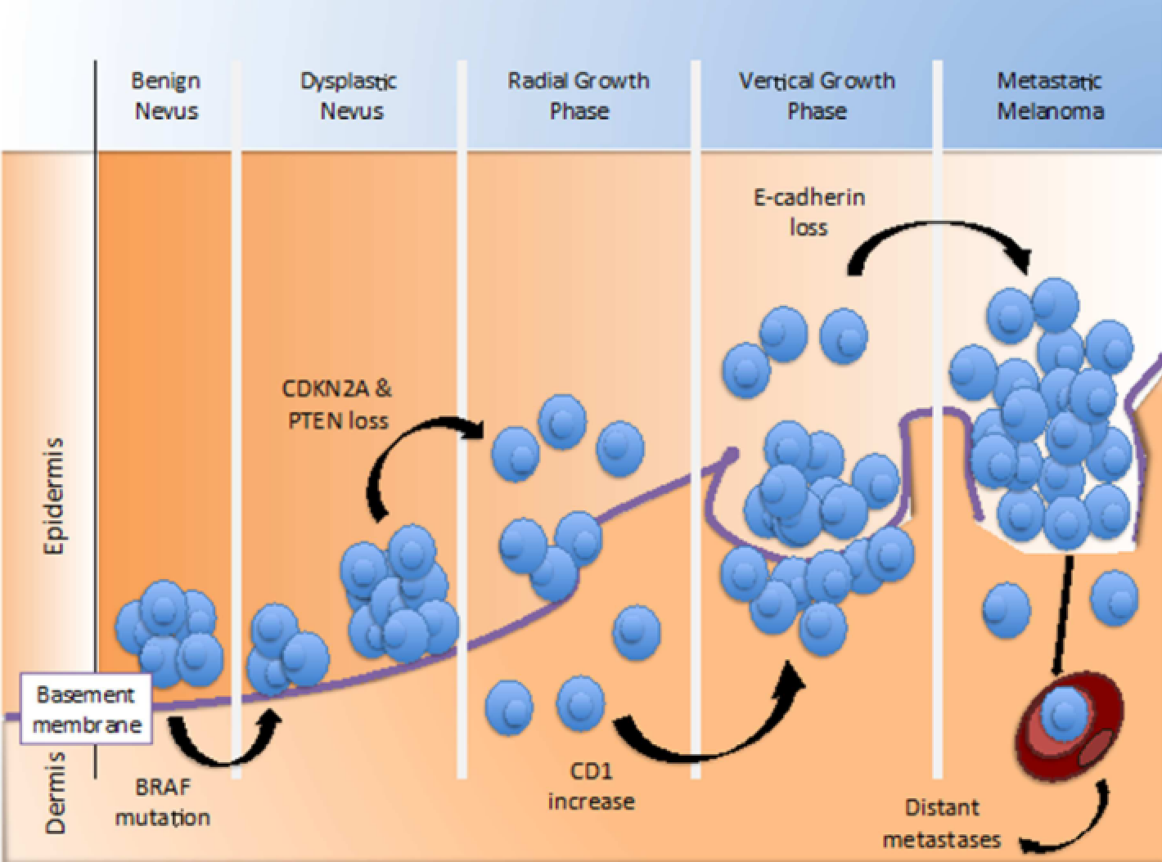
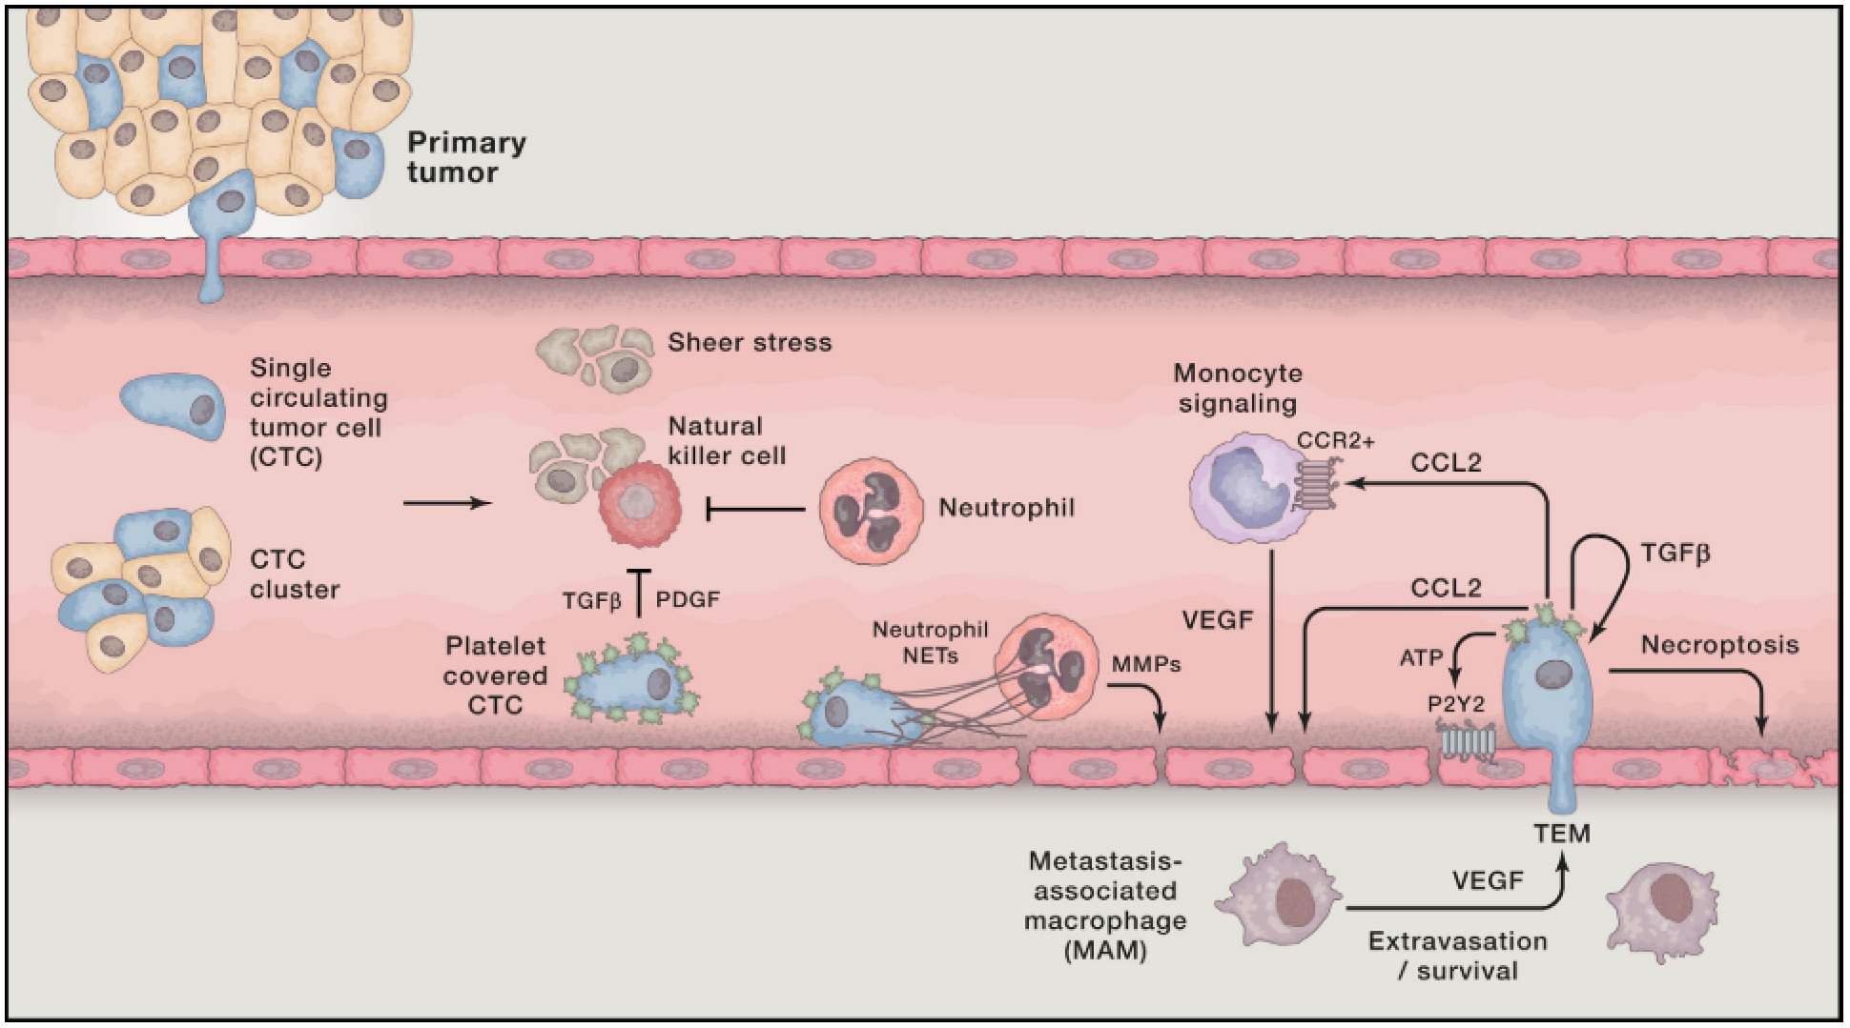
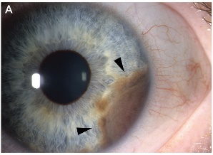
Background
Melanoma
Survival
63-90% (primary)
5-19% (metastatic)
3 major pathways
MAPK, PI3K/AKT, p16INK4A
BRAF mutated in 40-60% of cases
Therapies:
Surgery, immunotherapy, targeted therapy, chemotherapy, radiation
Metastasis
Seeding
Immune recruitment
Colonization
Adapted from (Arrangoiz, 2016)
(Lambert, 2017)
Cutaneous
Uveal

Slide 3
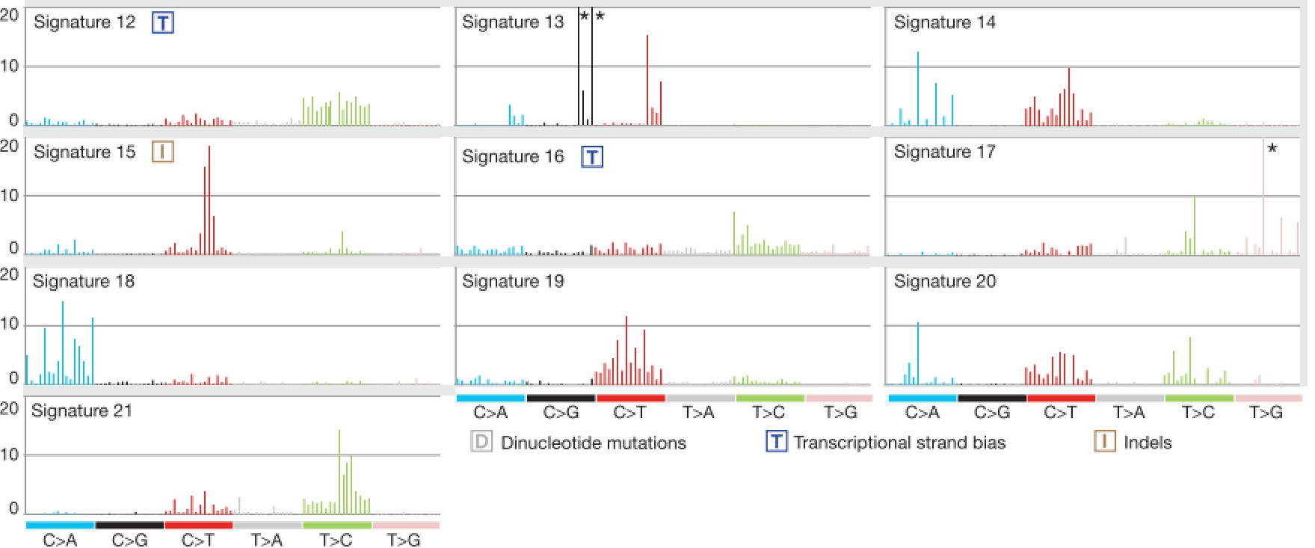
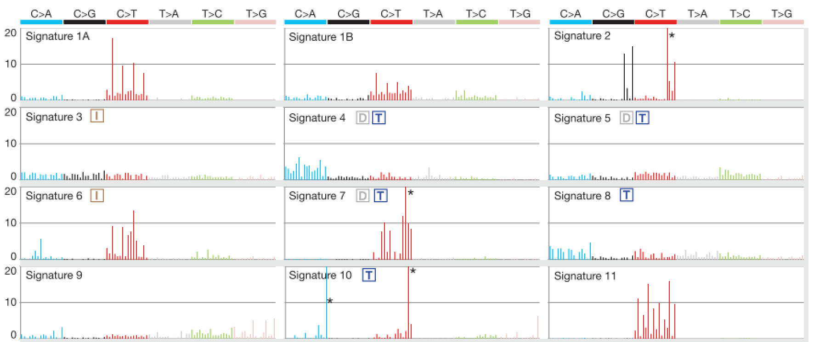
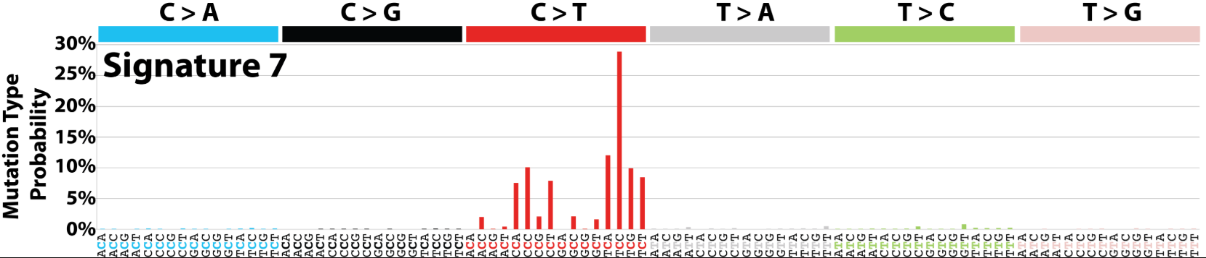
Background
Mutational signatures
Context-specific somatic mutations
Two adjacent bases are important
Example: T[C]C > T[T]C
Associated to risk factors
Signature 7: UV light exposure
COSMIC https://cancer.sanger.ac.uk/cosmic/signatures
(Alexandrov, 2013)

Slide 4
Aims
Investigate impact of risk factors in melanoma
Disease progression (early metastatic transition)
Impact of different therapies on survival
Mutational signatures
Mutational signatures extraction
Metastatic scoring
Marker genes selection
Therapy impact
Survival analysis
Gene expression data
Scoring
Analysis of differences

Slide 5
Results

Slide 6
Sample | Signatures | Etiology
SKCM | S7 | UV light exposure
 | S1 | Aging
 | S11 | Alkylating agents
 | S23 | Unknown, found
 | S6 | Defective DNA mismatch repair
UVM | S1 | Aging
 | S22 | Aristolochic acid
 | S15 | Defective DNA mismatch repair
 | S3 | DNA double-strand break repair failure
 | S6 | Defective DNA mismatch repair

Slide 7

Metastatic scoring
Upregulated in metastatic samples
42 genes
SKCM
UVM
$$\text{Metastatic} \text{potential} \text{score}= \frac{\text{Avg} \text{expression} \text{upregulated} \text{genes}}{\text{Avg} \text{expression} \text{downregulated} \text{genes}}$$
Differentially expressed in TCGA cohort
63 genes
cBioportal and literature
119 genes
Downregulated in metastatic samples
21 genes
Upregulated
5 genes
Literature
13 genes
Downregulated
8 genes

Slide 9
Low metastatic potential
High metastatic potential

Slide 10
SKCM TP
UVM TP

Slide 11
S7
S1

Slide 12
S7
S1

Slide 13
CoxPH survival models TCGA
SKCM primary tumors (n = 27)
SKCM metastatic tumors (n = 21)
Variable | Coefficient | HR | Standard error | Z | Pr(>|z|)
S11 | 6.55 | 6.96E+02 | 3.24 | 2.0200 | 0.0434*
S23 | 1.09E+01 | 5.22E+04 | 4.80 | 2.2620 | 0.0236*
Stage III | 2.52 | 1.24E+01 | 6.44E-01 | 3.8480 | 0.0001*
Variable | Coefficient | HR | Standard error | Z | Pr(>|z|)
Interferon | -3.625 | 2.67E-02 | 1.44 | -2.517 | 0.0118*
Interferon + radiation | -2.882 | 5.60E-02 | 1.462 | -1.972 | 0.0486*
Radiation | -3.981 | 6.87E-03 | 1.71 | -2.913 | 0.0036*
S7 | -2.763 | 6.31E-02 | 1.049 | -2.635 | 0.0084*
S6 | 1.206 | 1.73E-05 | 5.313 | 2.270 | 0.0232*
Log rank test: p = 4 x 10⁻⁵
Concordance: 72.9%
Log rank test: p = 0.02
Concordance: 68.1%

Slide 14
CoxPH survival models ICGC
Australian sample (n = 50): stage only
Brazilian sample (n = 95)
Variable | Coefficient | HR | Standard error | Z | Pr(>|z|)
Stage II | 0.0503 | 1.0517 | 0.3979 | 0.127 | 0.8993
Stage III | 0.6453 | 1.90649 | 0.4183 | 1.543 | 0.1229
Stage IV | 1.2931 | 3.6441 | 0.5964 | 2.168 | 0.0301*
Variable | Coefficient | HR | Standard error | Z | Pr(>|z|)
Stage II | 1.5725 | 4.8189 | 0.7749 | 2.029 | 0.0424*
Stage III | 1.7821 | 5.9426 | 0.7722 | 2.739 | 0.0210*
Stage IV | 2.1183 | 8.3172 | 0.7733 | 2.739 | 0.0062*
Immuno-therapy | -0.1028 | 1.1082 | 1.0548 | 0.097 | 0.9224
No treatment | -1.1033 | 0.3319 | 0.3429 | -3.126 | 0.0012*
Radiation | 2.0233 | 7.5632 | 0.8888 | 2.277 | 0.0228*
Surgery | -0.8600 | 0.4232 | 0.3849 | -2.234 | 0.0255*
Log rank test: p = 0.07
Concordance: 60.7%
Log rank test: p = 0.02
Concordance: 68.1%

Slide 15
Some limitations…
Sample size
Lack of matched samples
No matched control data
Missing survival, therapy, clinical data
Australian cohort models with more samples
TCGA cohorts in ICGC samples
…
… and work to be done

Slide 16
References
Alexandrov LB, Nik-Zainal S, Wedge DC, et al. Signatures of mutational processes in human cancer. Nature. 2013;500(7463):415-421.
Arrangoiz R. Melanoma Review: Epidemiology, Risk Factors, Diagnosis and Staging. J Cancer Treat Res. 2016;4(1):1.
Forbes SA, Bindal N, Bamford S, et al. COSMIC : mining complete cancer genomes in the Catalogue of Somatic Mutations in Cancer. 2018;39(October 2010):945-950.
Lambert AW, Pattabiraman DR, Weinberg RA. Emerging Biological Principles of Metastasis. Cell. 2017;168(4):670-691.
Sandru A, Voinea S, Panaitescu E, Blidaru A. Survival rates of patients with metastatic malignant melanoma. J Med Life. 2014;7(4):572-576.

